Slide 1




Minders’ 25
FrontEnd
Workshop
Session Four

Slide 2



Table of contents
01
02
Recap
Grid
03
Responsive Design

Slide 3
01
Recap

Slide 4

Come to the stage
يا حلو (*_*)

Slide 5

02
Grid

Slide 6
We’ve learned Flexbox, so why do we need CSS Grid?
Think of Flexbox as arranging train cars on a track… and Grid as arranging buildings in a city.
Grid is two-dimensional (rows and columns at the same time).
Flexbox is one-dimensional (row or column at a time).
Grid shines for full page layouts or components that require precise control of both dimensions.
Flexbox is still great for aligning items in a single line or distributing space dynamically.

Slide 7
02
Grid
1- Display
2- Grid-template-columns
3-grid-template-rows
4-Grid-column
5-Grid-row
6-Grid-template-areas

Slide 8
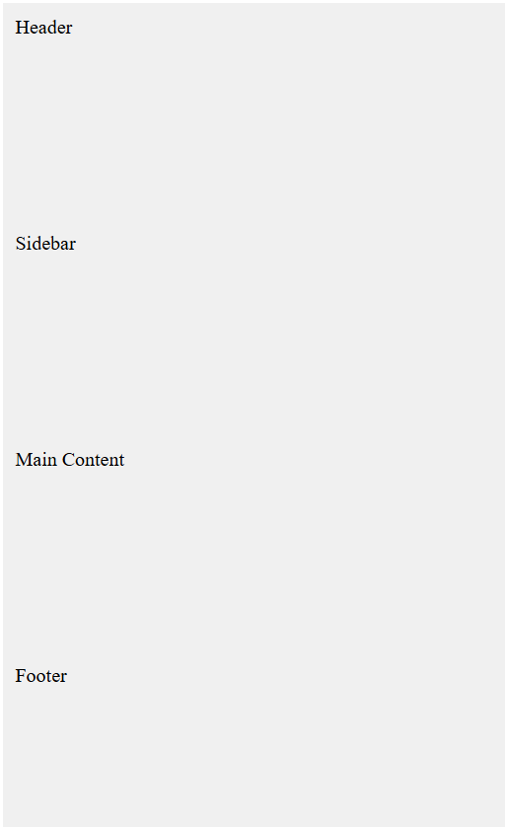
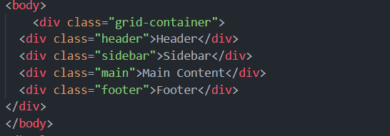

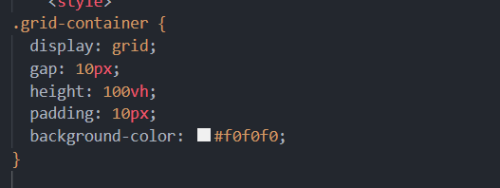
02
Display : Grid

Slide 9
02
Grid
Grid-template-columns
1-fixed-width Columns
2-Flexible Columns
3-repeat Syntax
4- Auto Columns
5- Min and Max

Slide 10
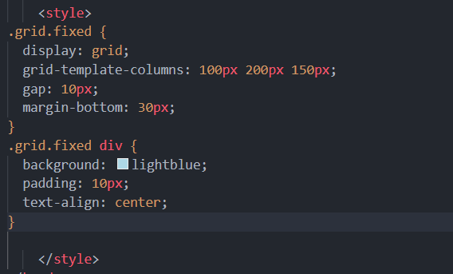
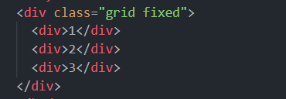

02
Grid-template-columns
1- Fixed

Slide 11
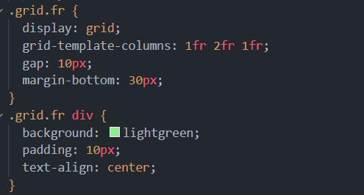
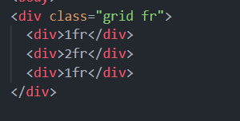

02
Grid-template-columns
2-Flexible Columns

Slide 12
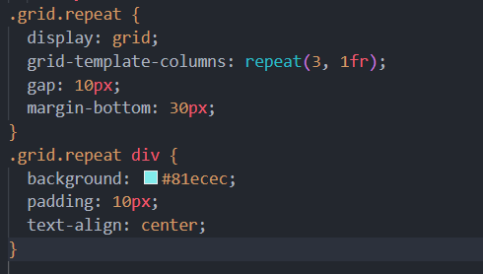

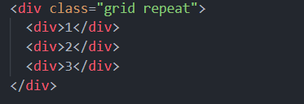

02
Grid-template-columns
3- repeat Syntax

Slide 13
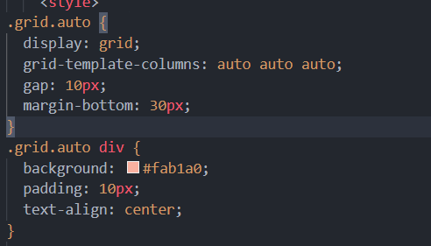
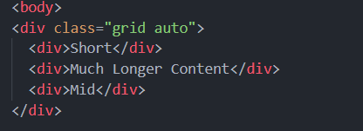

02
Grid-template-columns
4- Auto Columns

Slide 14
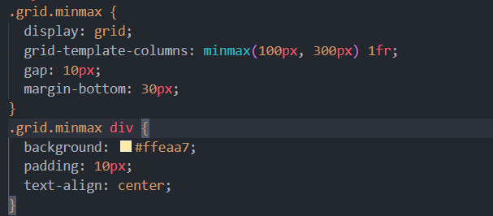
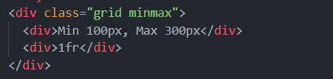

02
Grid-template-columns
5- MinMax

Slide 15
02
Grid
Grid-Template-rows
1-fixed rows
2- Flexible rows
3- Auto rows
4- minmax
5-repeat

Slide 16
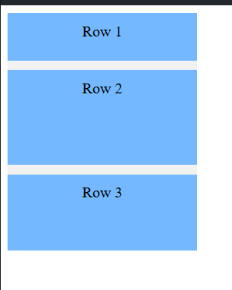
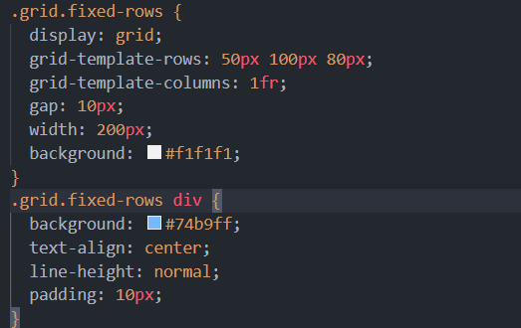
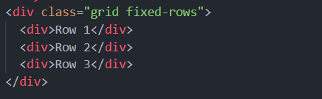
02
Grid-Template-rows
1-Fixed Row

Slide 17
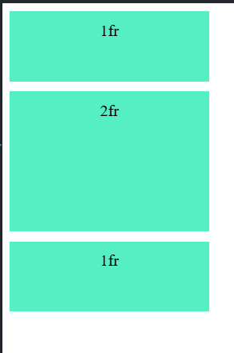
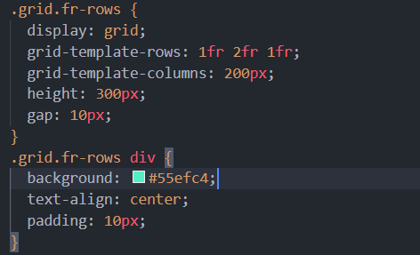
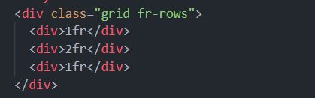
02
Grid-Template-rows
2- Flexible rows

Slide 18
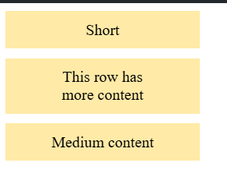
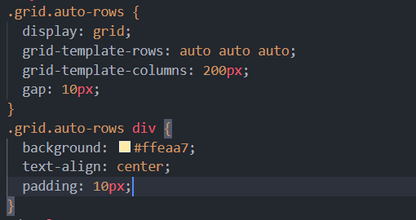
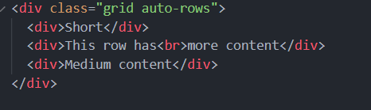
02
Grid-Template-rows
3- Auto rows

Slide 19
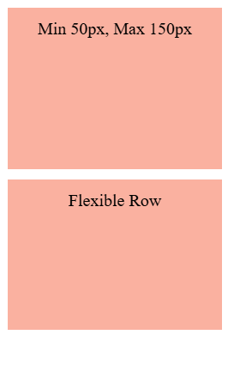
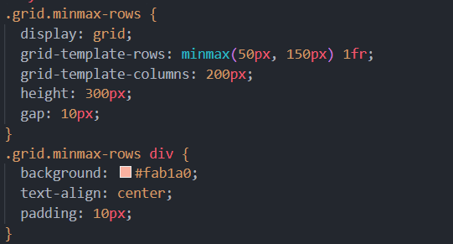
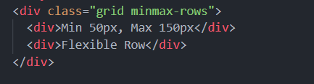
02
Grid-Template-rows
4- MinMax

Slide 20
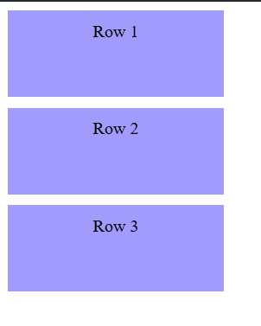
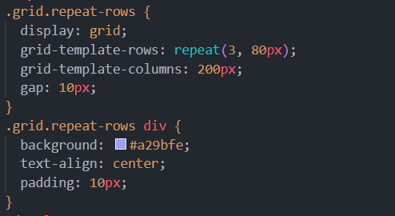
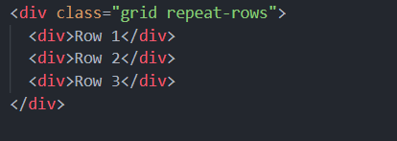
02
Grid-Template-rows
5- repeat Syntax

Slide 21
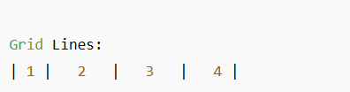


02
Grid-Columns
The item will start at line 1 and end before line 3, taking up 2 columns.

Slide 22
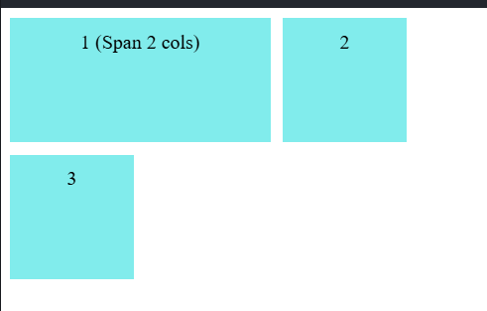
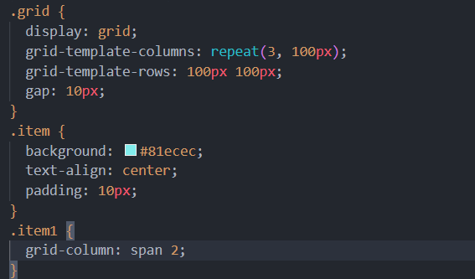
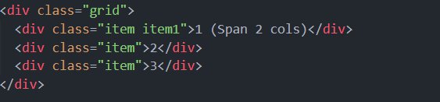
02
Grid-Columns

Slide 23
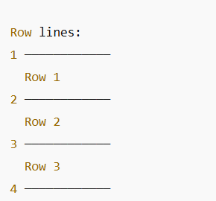


02
Grid-Row
Start at line 1 (top).
End at line 3 (which means span 2 rows)

Slide 24
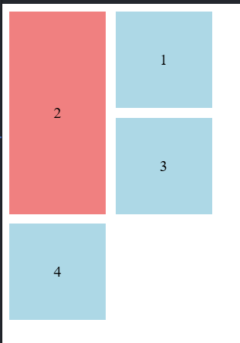
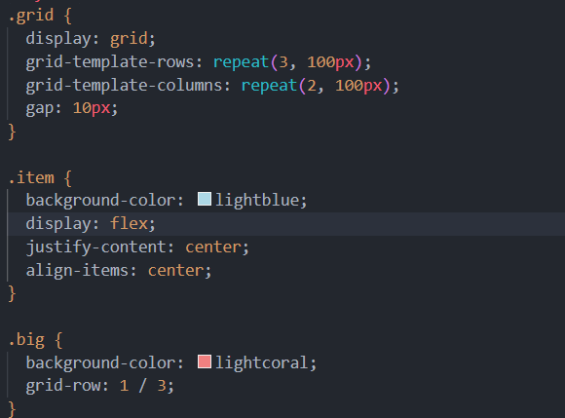
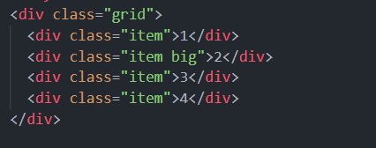
02
Grid-Row

Slide 25
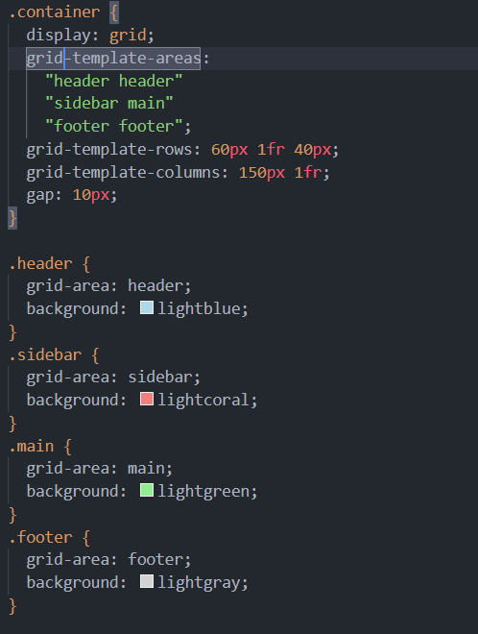
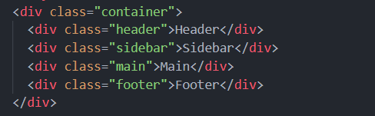
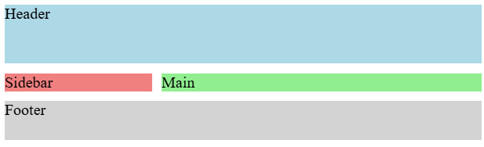
02
Grid-Row

Slide 26

Task One

Slide 27
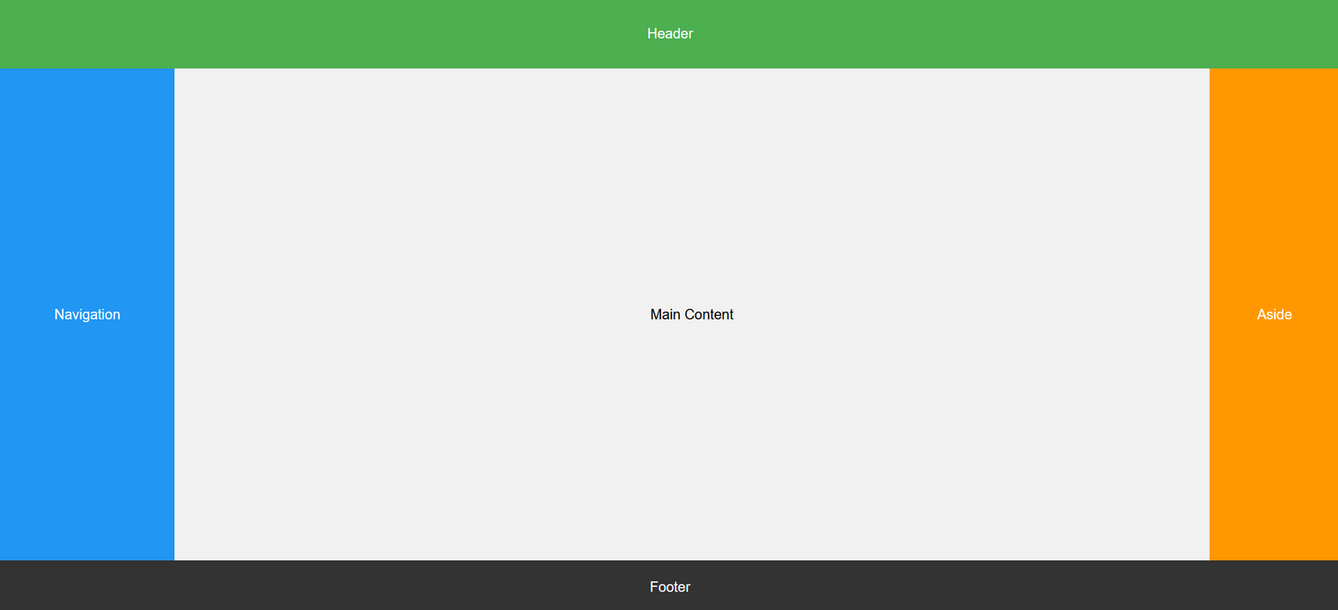

Slide 28
03
Responsive Design

Slide 29
03
Responsive Design
We all know websites must be responsive nowadays, but do I have to recode my entire design separately for every screen size?

Slide 30
03
Responsive Design
Responsive design allows your content to automatically adapt its layout, images, and text based on the device's screen size and orientation.
1-Fluid Grid layout
2-Flexible Images
3-Media Queries

Slide 31
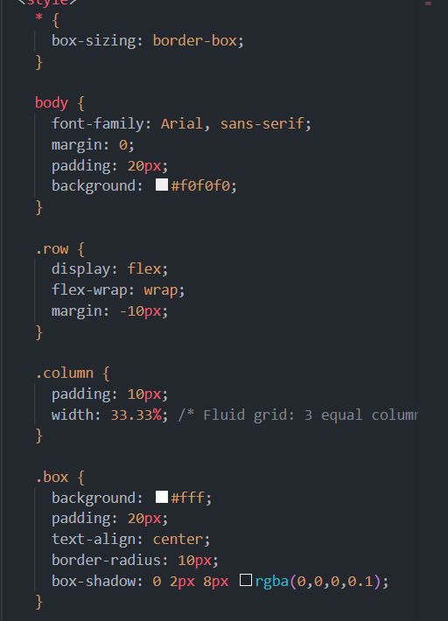
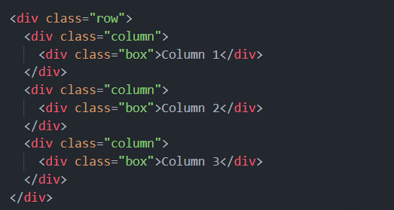

03
Responsive Design
1- Fluid Grid

Slide 32
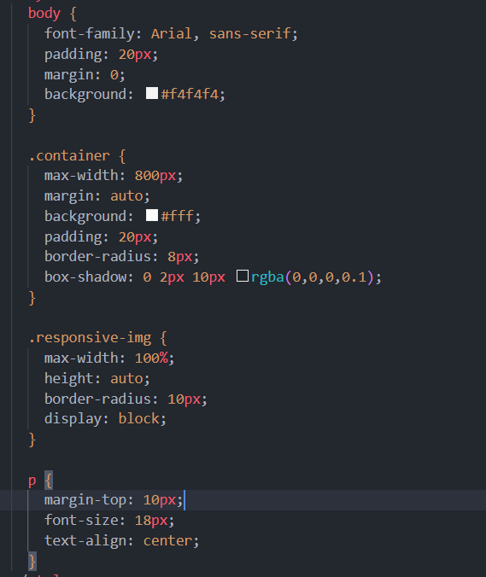
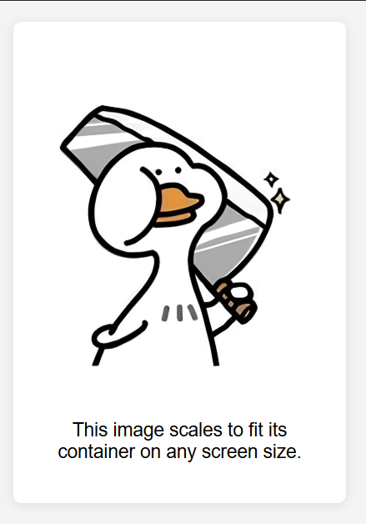
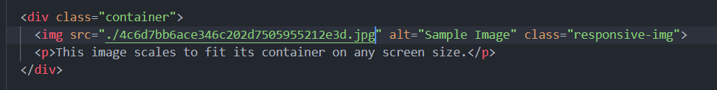
03
Responsive Design
2-Flexible Image

Slide 33
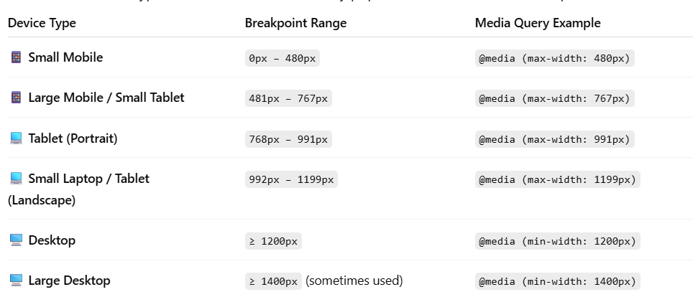
03
Responsive Design
3-Media Queries

Slide 34
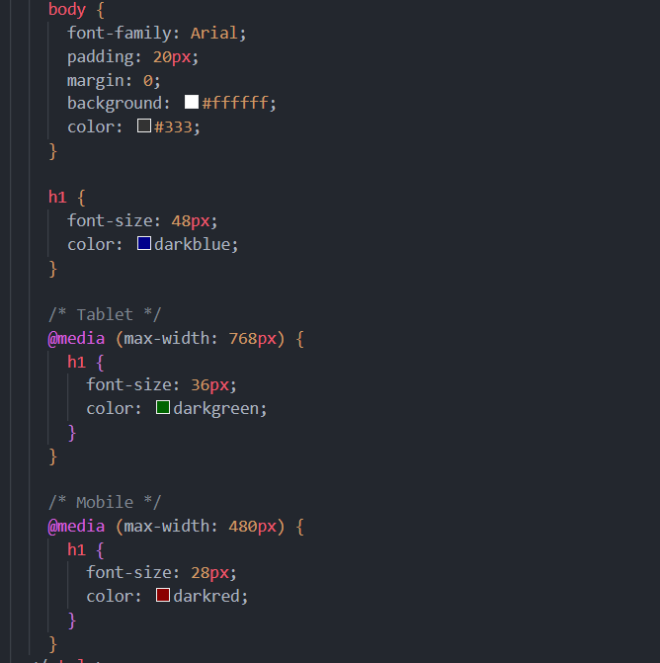
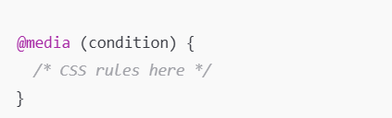
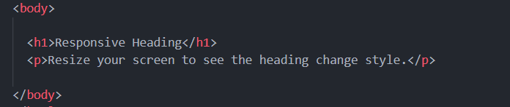
03
Responsive Design
3-Media Queries

Slide 35

03
Responsive Design
3-Media Queries

Slide 36

03
Responsive Design
3-Media Queries

Slide 37
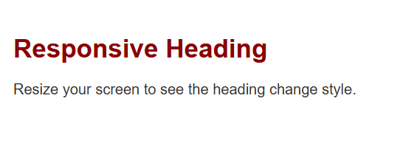
03
Responsive Design
3-Media Queries

Slide 38


Task Two

Slide 40
Conclusion

Slide 41
Thanks for Your attention with us (☆▽☆)
Have Good weekends with the tasks o(≧∀≦)o

